Slide 1

Where should the next Waitrose be built?
Kevin Brown
Disclaimer: Waitrose are not aware of the project, and I am not in any way affiliated with them

Slide 2
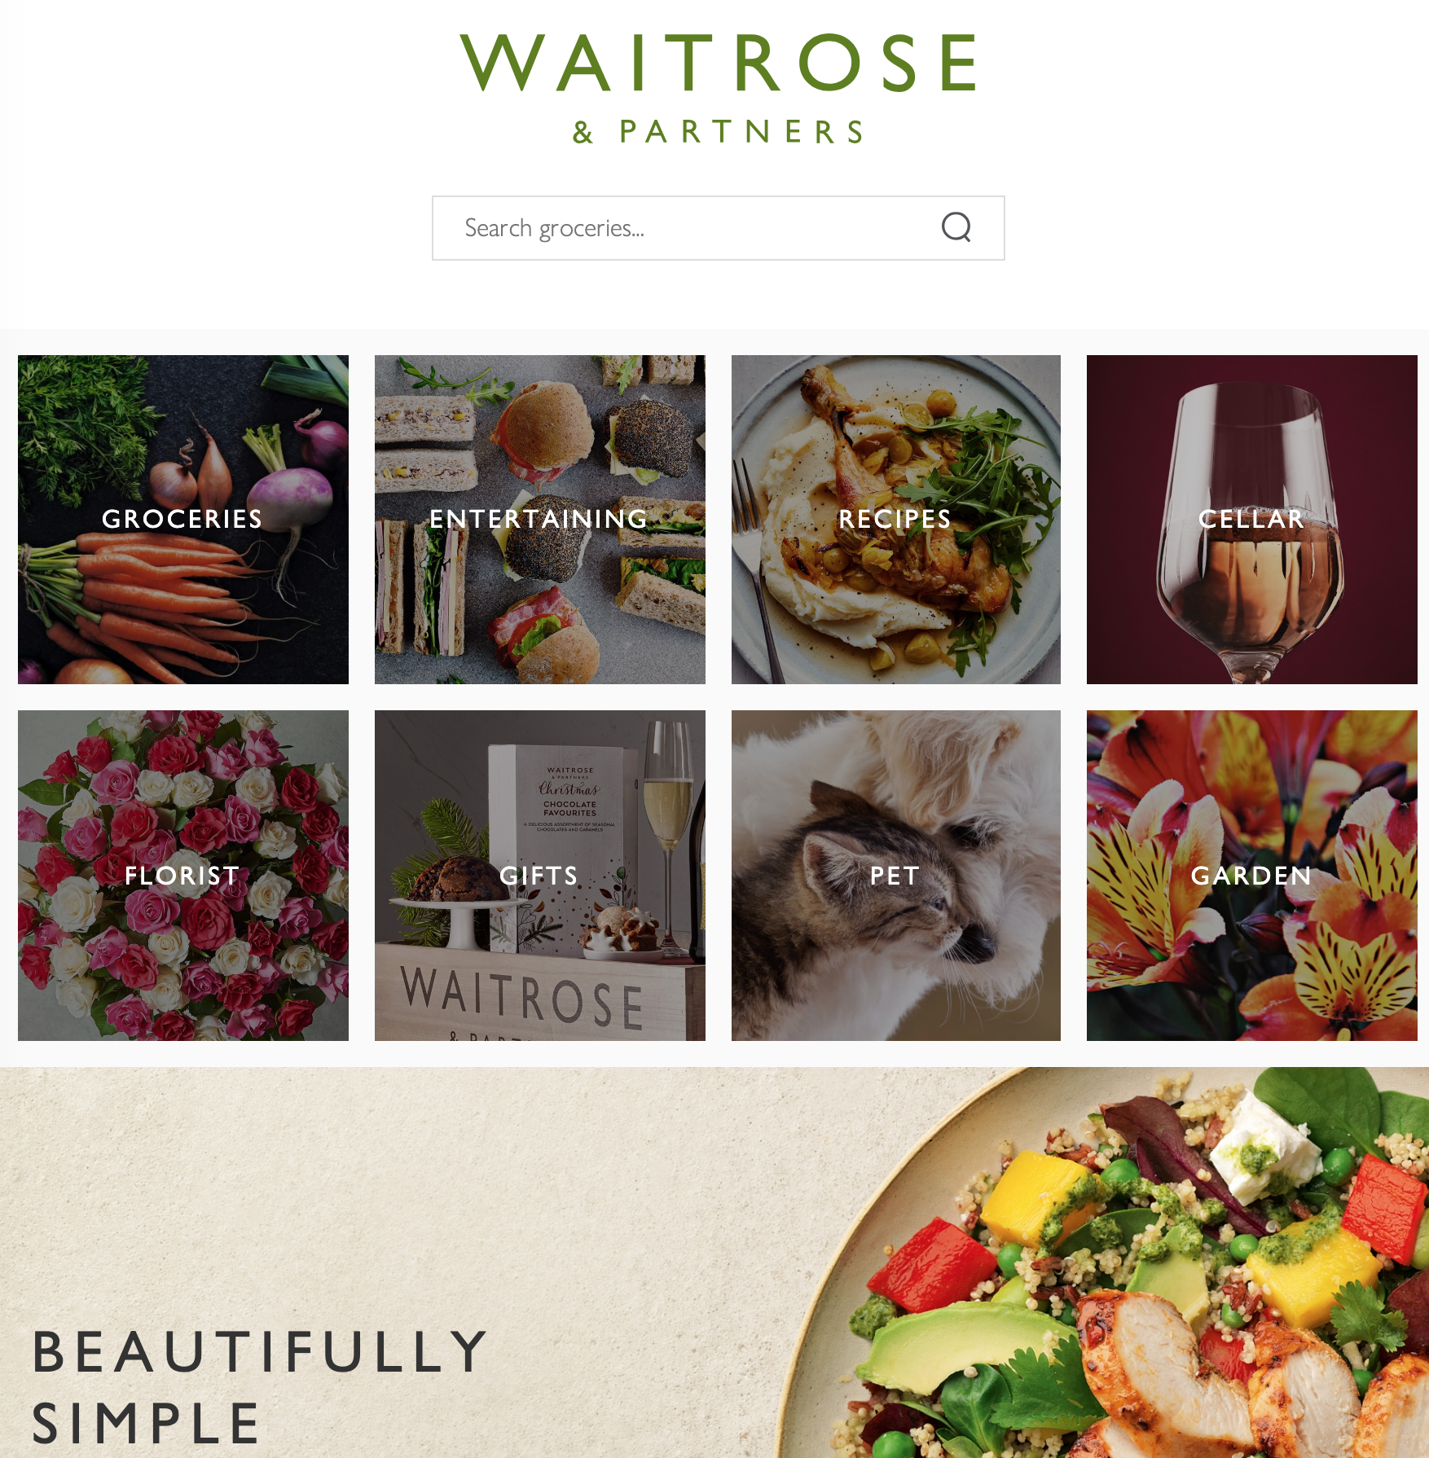
Introduction
Waitrose is a ‘higher end’ supermarket in the UK – aimed at a particular market segment
Taking into account current supermarket locations and neighbourhoods, can we find potentially suitable locations for building new supermarkets?

Slide 3
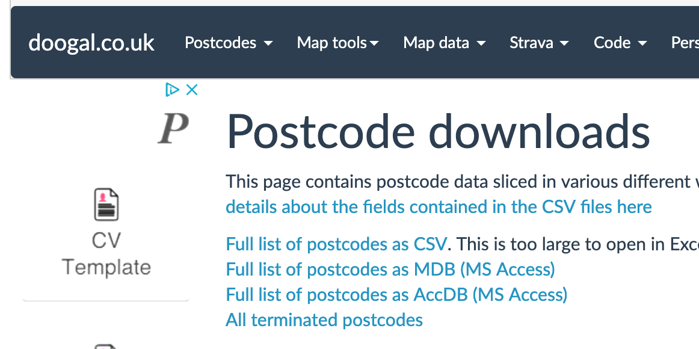
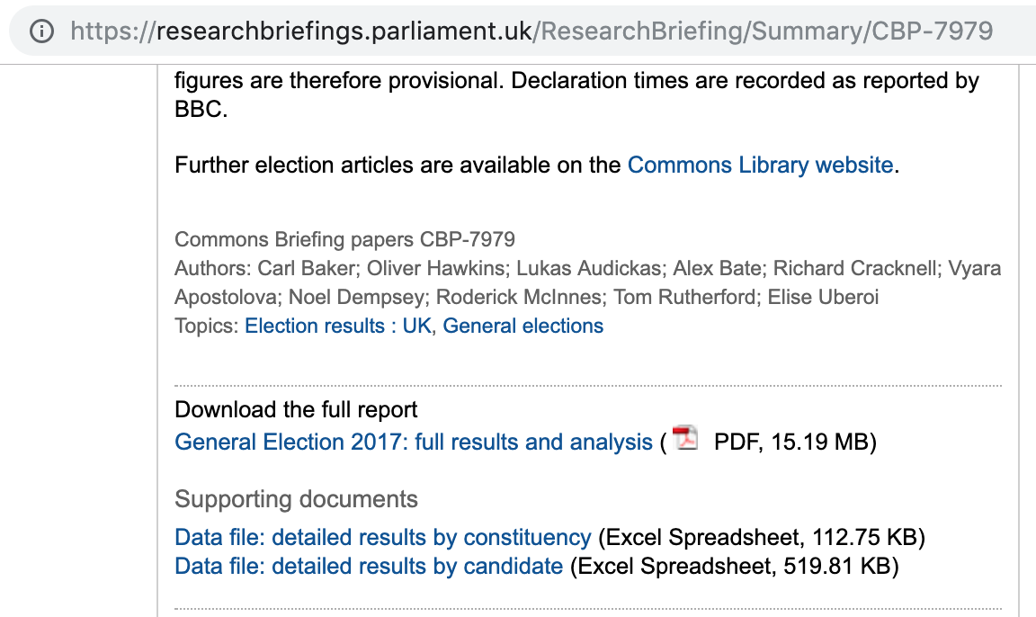
Data Sources
Waitrose.com provided a web page of A-Z store list and individual store pages.
Doogal.co.uk provided a full list of UK postcodes as CSV. As a bonus, it provided constituency id, and the postcode’s Deprivation Index.
Parliament.uk provided a list of election results by constituency as CSV
Foursquare provided a list of venues around communities in the UK, via a REST API.

Slide 4
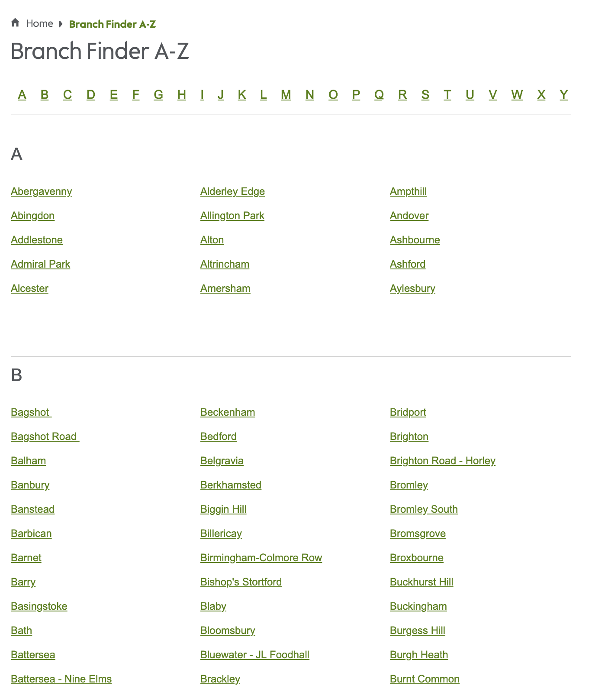
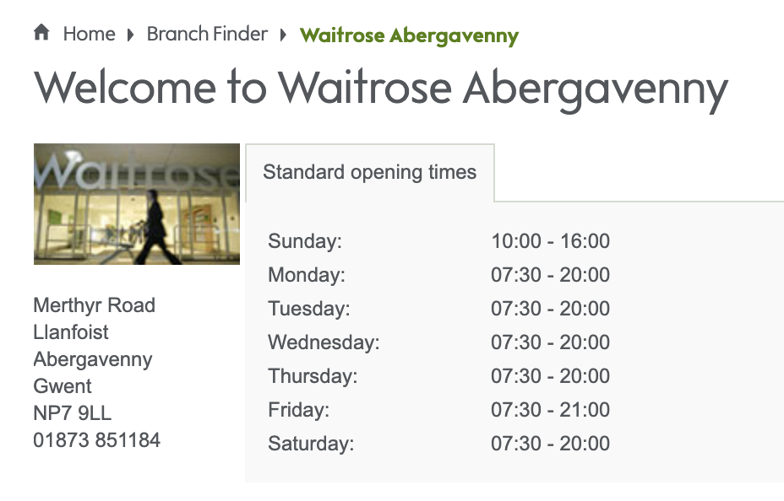
DATA COLLECTION: Stores
Scraped A-Z and individual Store pages on Waitrose Web site
Had to fix Peterborough which is listed on the A-Z but has now closed

Slide 5
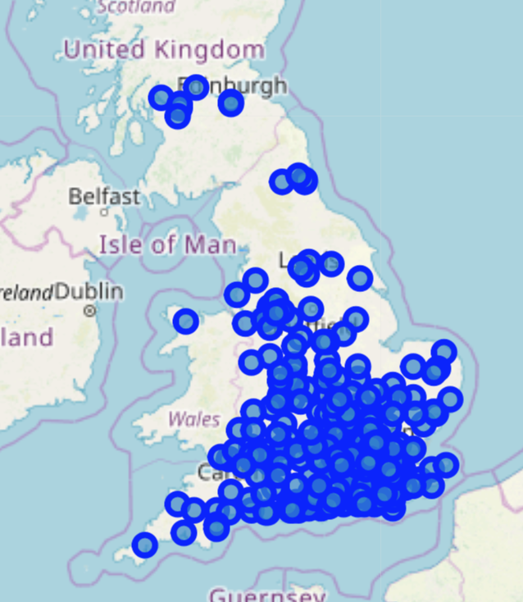
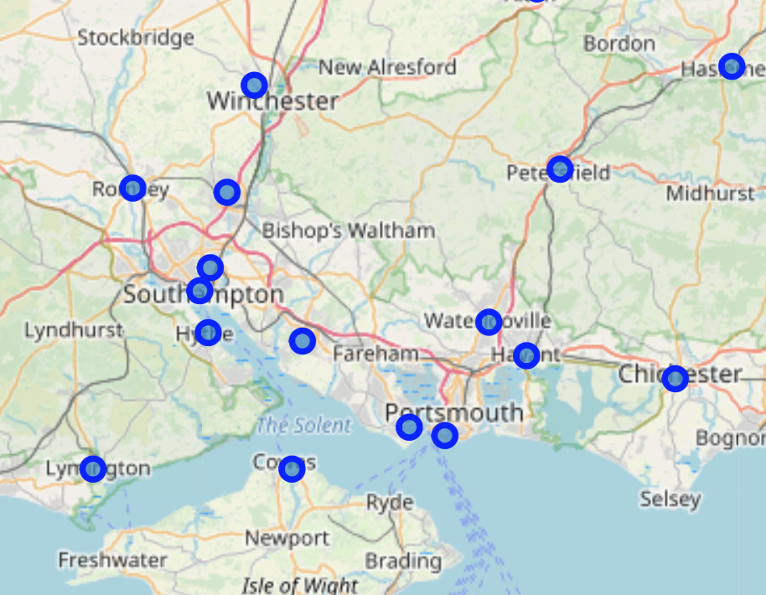
Data Exploration: Store location

Slide 6
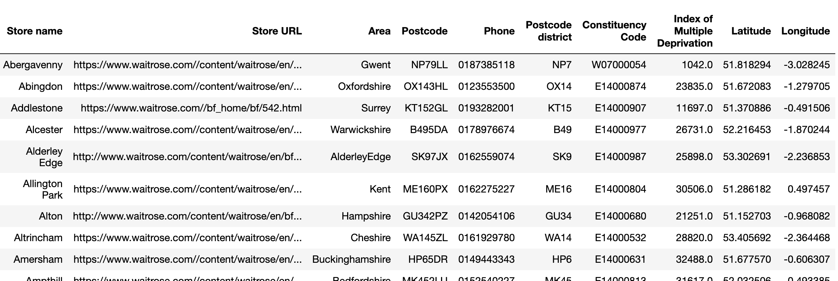
Data collection: Political
Added Lat/Lon, Constituency ID, Deprivation index from Doogal.co.uk

Slide 7
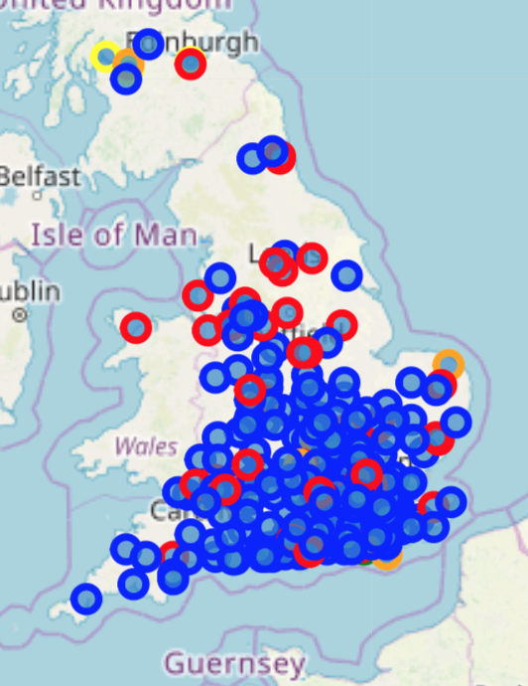
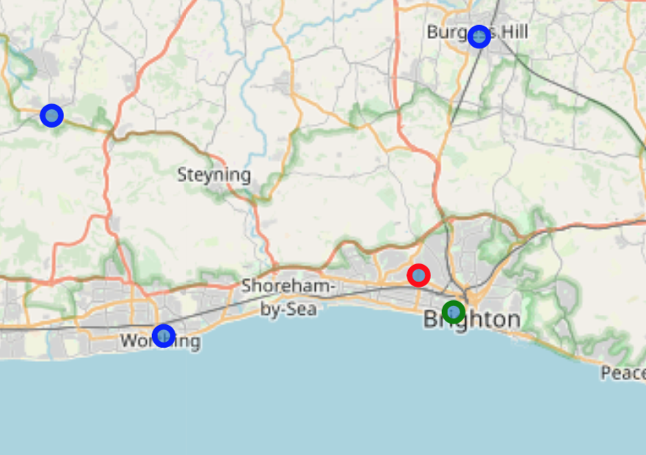
Data exploration: Political
Maps showing all stores coloured by political party for the constituency each belongs to
The predominant colour where Waitrose is coloured is blue (Conservative).
Can we conclude there is a bias toward Conservative areas? Not quite yet…

Slide 8
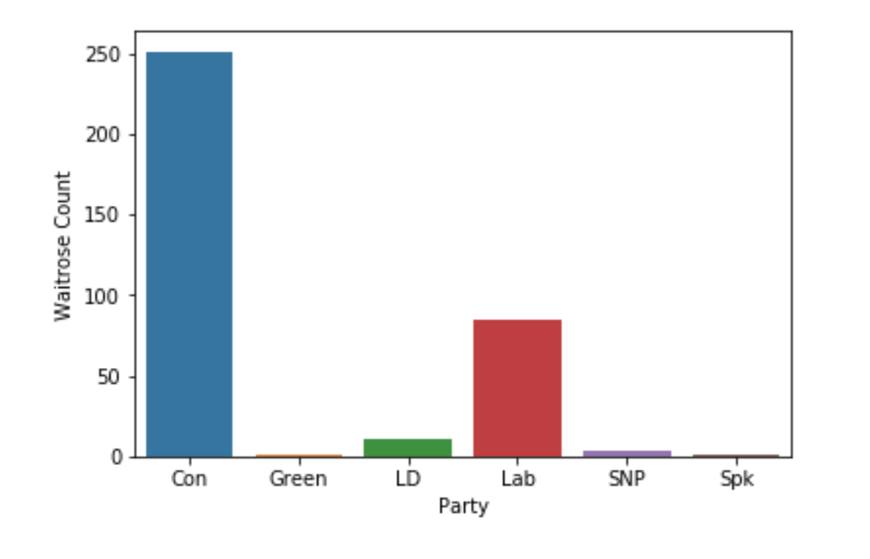
Data exploration: Political
The chart showing number of stores per political party confirms that there are more stores in conservative areas.
But it does not show whether it’s biased towards Conservative areas, or whether there are just more conservative areas in the country.

Slide 9
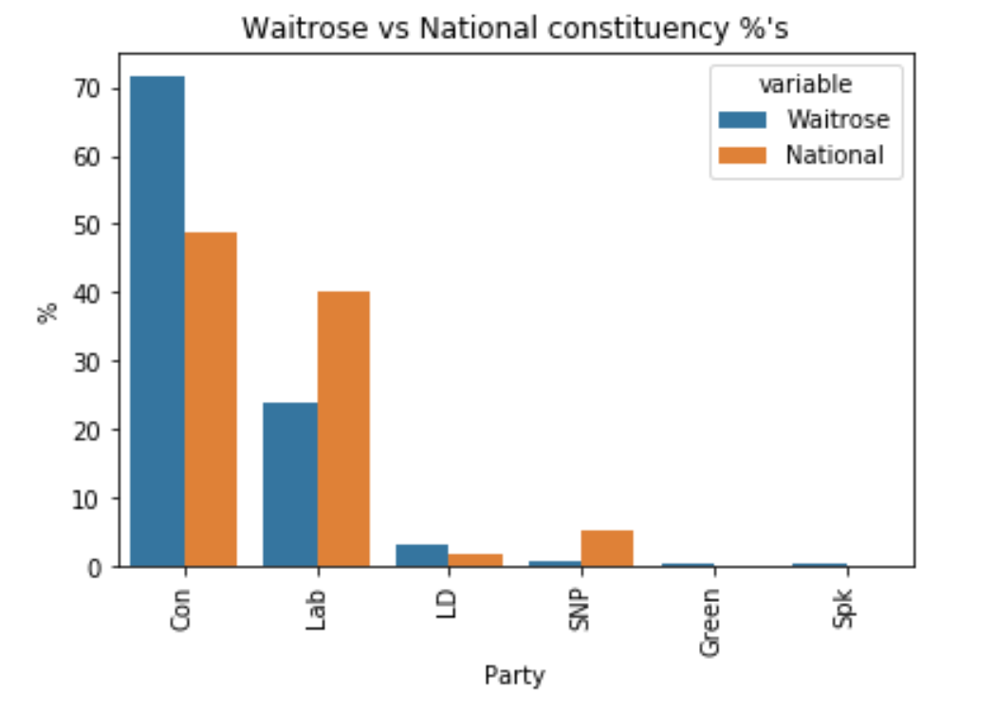
Data exploration: political
This chart shows the number of stores per political party as a percentage of total stores (blue), alongside the number of seats for the same political party as a percentage of total seats.
From this chart, we can conclude there is a bias (intended or not) towards placing Waitrose in Conservative held seats.

Slide 10
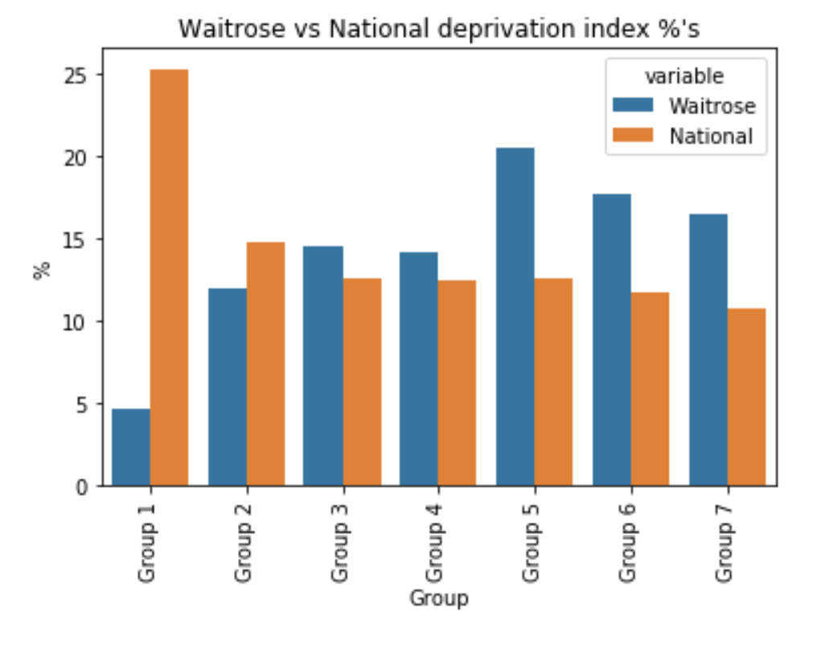
Data exploration: Deprivation
The deprivation rank for the postcode, where 1 is the most deprived. The range of values is as follows: 1 - 32844 = England 1 - 1909 = Wales 1 - 6976 = Scotland 1 - 890 = Northern Ireland
Used binning to split the deprivation index into groups, with Group 1 being most deprived
This chart shows the percentage of stores per deprivation group (blue), alongside the percentage of postcodes in the same deprivation group.
From this chart, we can conclude there is a bias (intended or not) towards placing Waitrose in the least deprived areas.

Slide 11
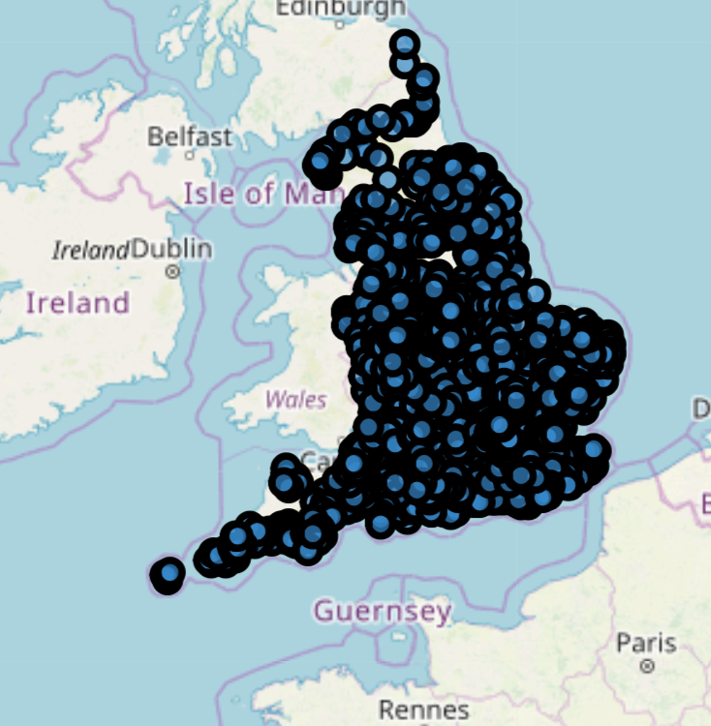
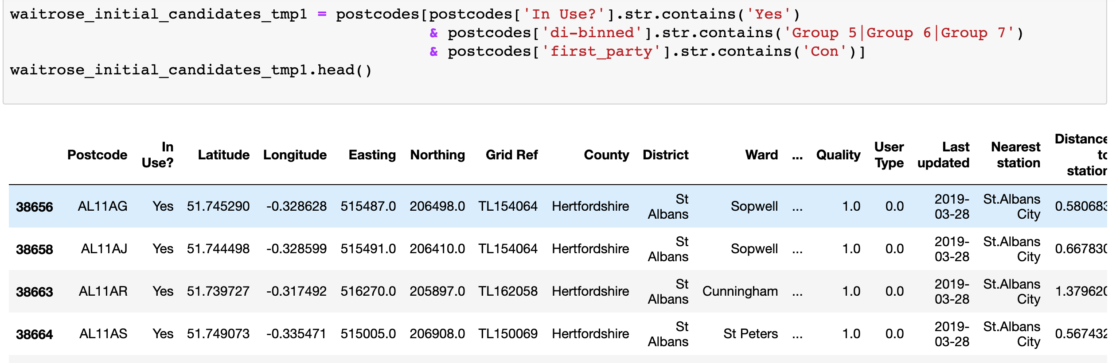
PREDICTION: INITIAL CUT
Later in the project we look at Foursquare data, but we’ll need an initial set of locations to investigate
Using the conclusions so far, we can select postal districts which have a conservative seat, and Group 5-7 deprivation index, which don’t already have a Waitrose, as a good first cut.
The new list of postcodes is plotted on a map.

Slide 12
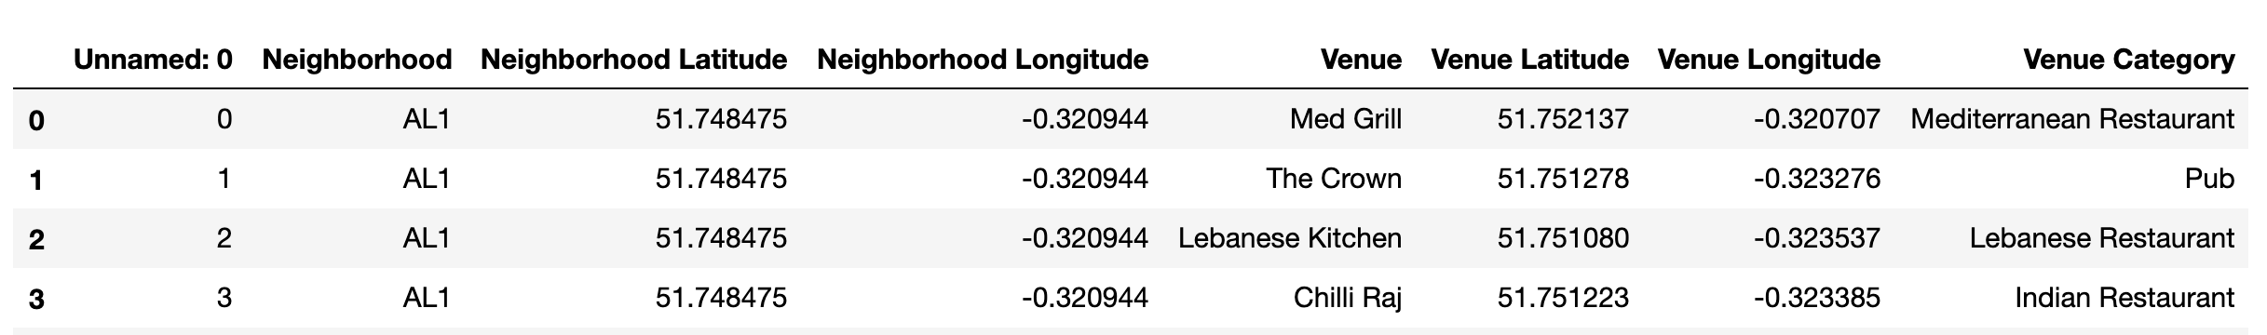
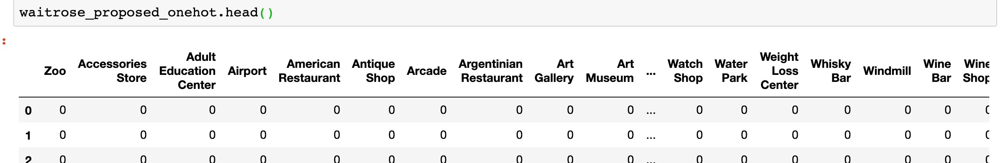
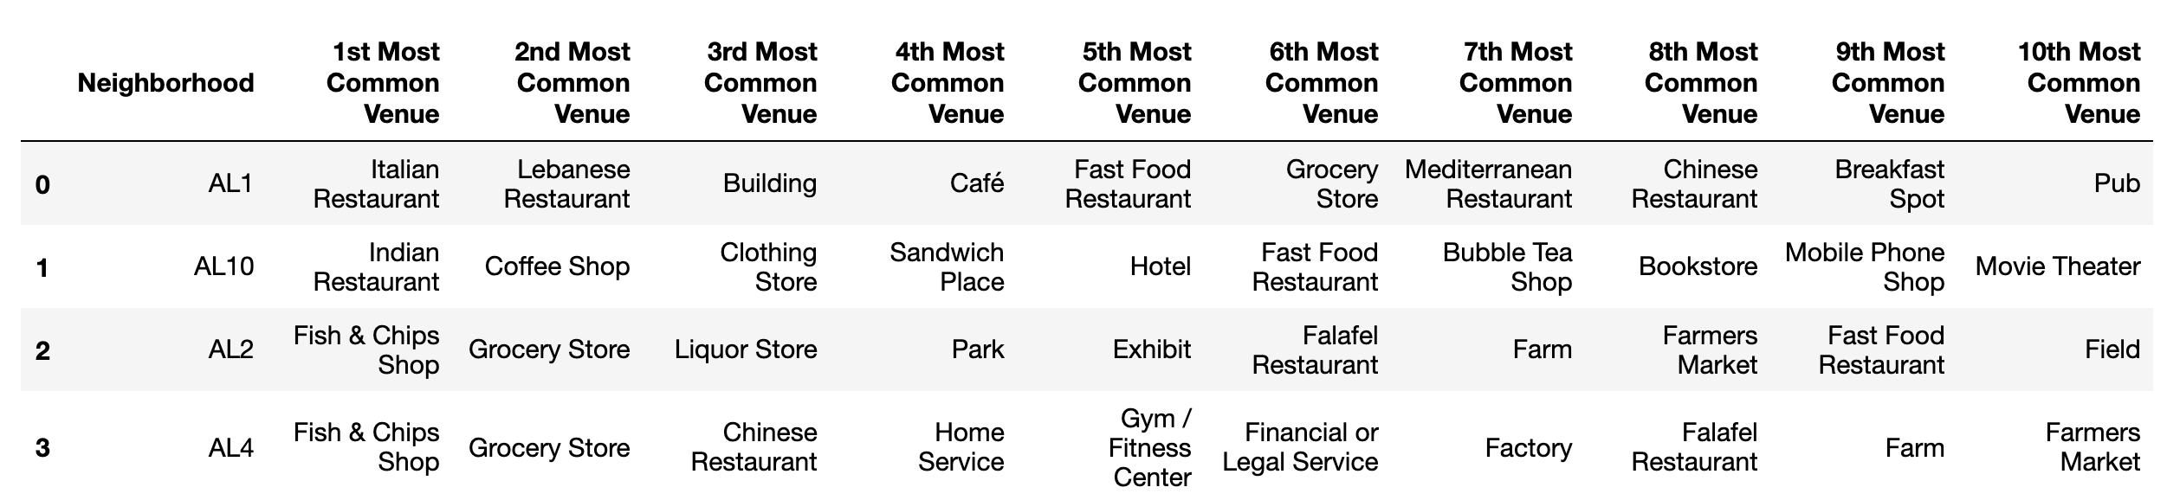
DATA COLLECTION: FourSquare
Collected the data from Foursquare for all the initial proposed sites
Performed one hot encoding ready for K-means clustering on the data
And discovered the most common choice of venues around each of the locations

Slide 13
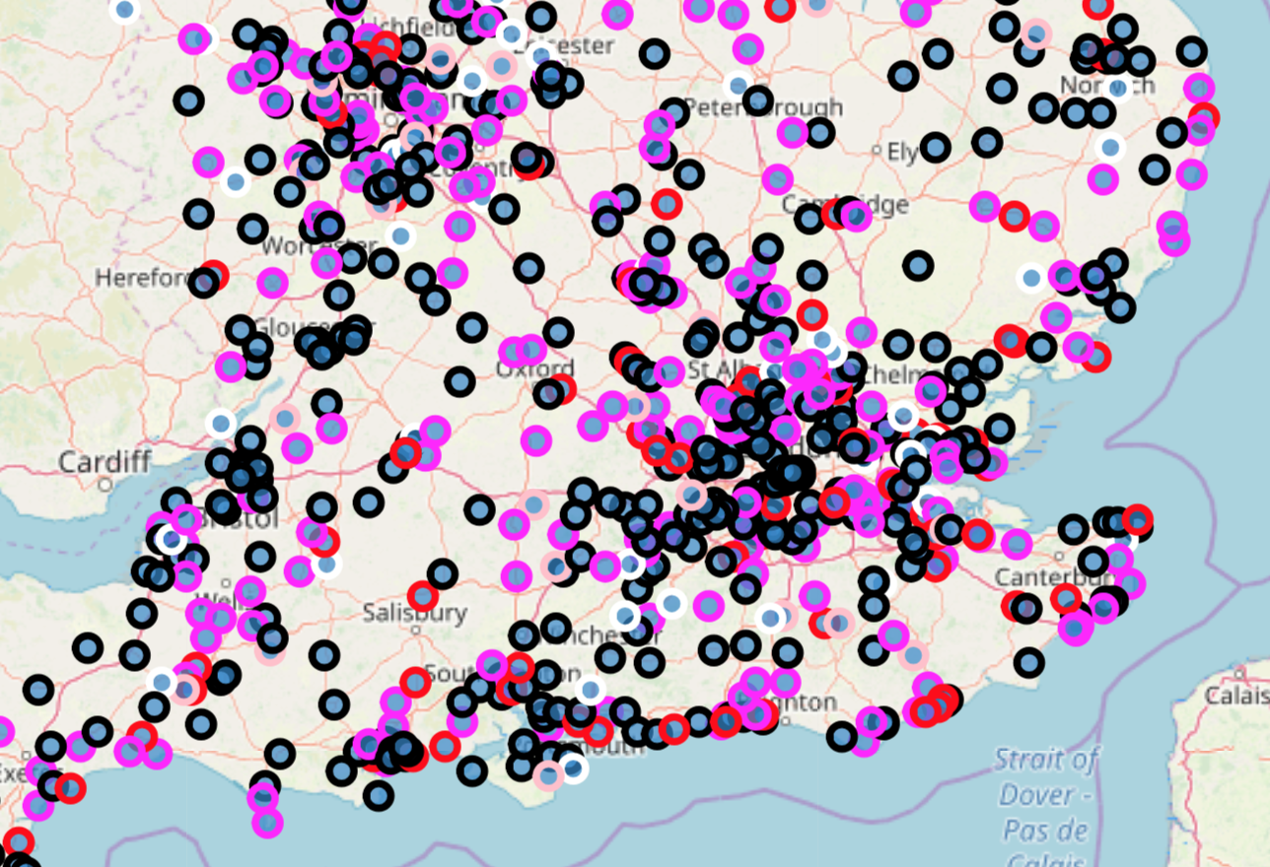
DATA Exploration: K-MEANS Clustering
K-Means clustering with 5 clusters grouped all the proposed locations into clusters labelled 0-4
The different clusters are shown with white, pink, red, magenta and black dots.
The K-Means model was saved and the Waitrose stores were then applied to it.
Will the stores be distributed amongst the clusters evenly, or will all the stores be in one cluster?

Slide 14
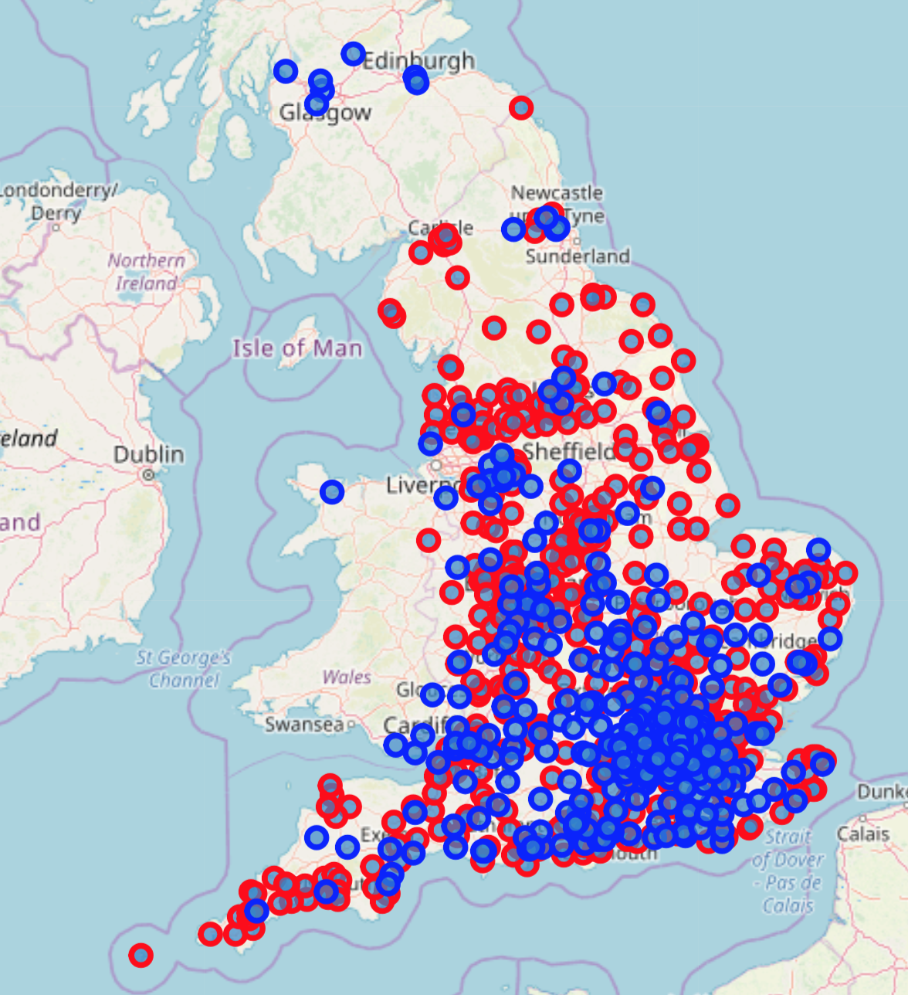
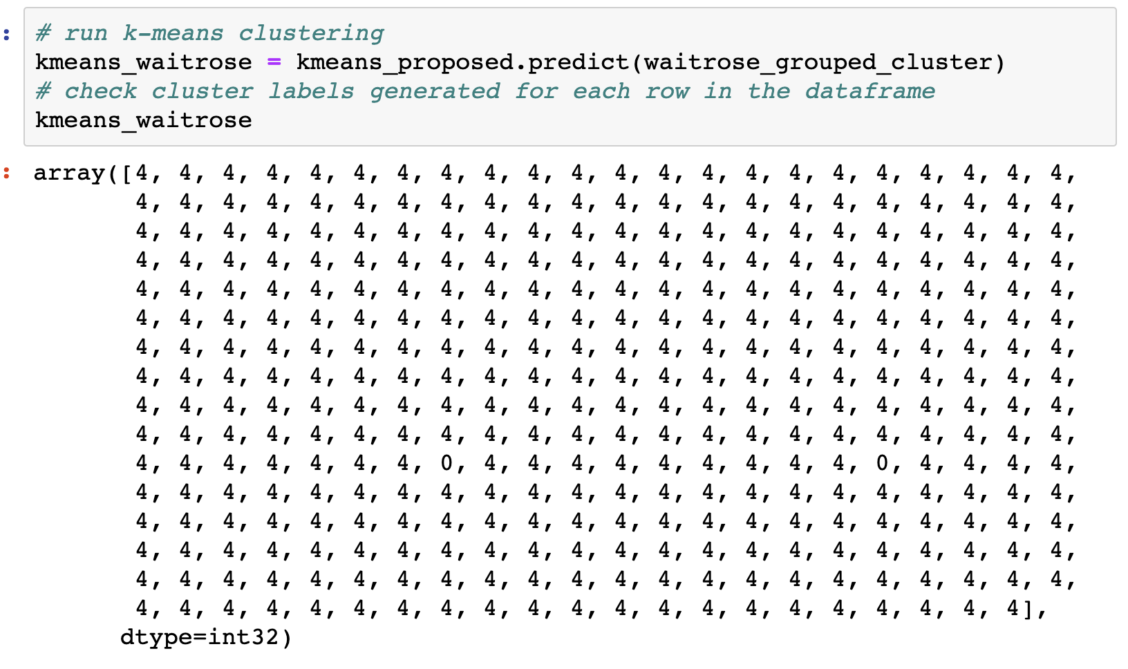
PREDICTION: PART 2
The K-means clustering model was presented with the venue data from the actual waitrose store locations, and nearly all of the neighbourhoods that they were located in fell into Cluster 4.
Clusters 0, 1, 2 and 3 from the initial dataset were removed and the results plotted on a map. Blue dots are 351 existing Waitrose stores, Red dots are 526 proposed new sites,

Slide 15
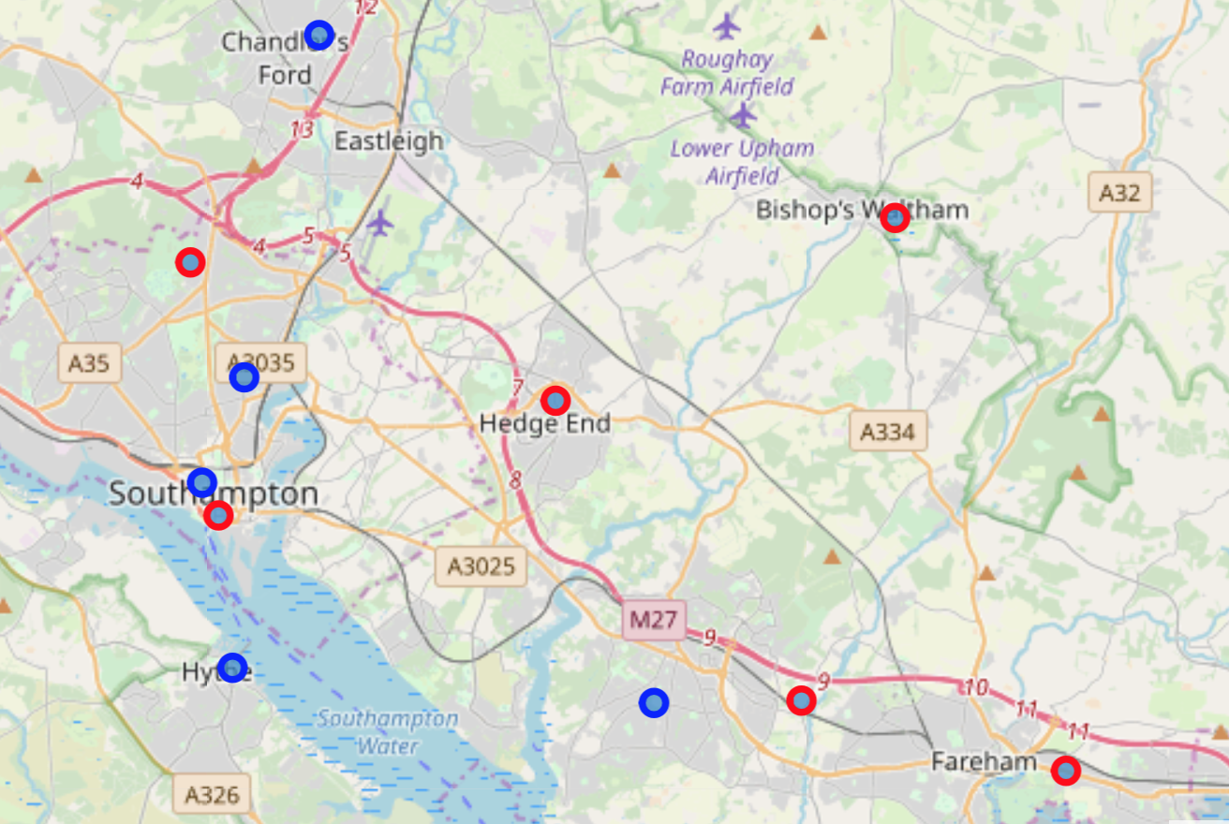
Data exploration: Local area
The current stores are marked in blue, the proposed sites are shown in red.
Living in the area shown on the map, I confirmed the locations were broadly unsurprising locations for Waitrose stores.

Slide 16
Bishops Waltham
I was surprised that Bishops Waltham (for example) did not have a Waitrose already, which confirmed to me that my results seemed sensible.

Slide 17
CONCLUSIONS
Waitrose is a higher end supermarket
There is a bias towards Conservative run areas
There is a bias towards areas which are least deprived
Waitrose are often found near pubs, coffee shops and restaurants.
500 similar neighbourhoods have been identified to those with Waitrose stores, and mapped, providing seemingly sensible locations for new Waitrose Stores
There could be a lot more done to refine the model further (see Extensions)

Slide 18
Extensions
There would be a lot more that could be done to refine and check the model.
Using more data - correlating with crime statistics and other neighbourhood features
Taking into account the results of each store (with access to confidential data) so only the best stores could be modelled
Taking into account the delivery depots, supply chains, proximity to other stores, size of stores etc., to make the results more compelling.
There could be more analysis (variance, correlations, p-Value etc) to help validate results. However for this project the bar charts and histograms were reasonably compelling.

Slide 19
Thank you
Any questions?

